Slide 1

Olist Ecommerce Analytics Dashboard
Data Analysis using Excel, SQL, Power BI, and Tableau

Slide 2
Group-5
Vinayaka N
Ganji. Syam Prasad Naidu
Sanjay Reddy Challa
Sura Venkata Rachana
Lingareddy premanandareddy

Slide 3

INDEX
Introduction
KPIs and Insights
Excel Dashboard
Power BI Dashboard
MySQL Queries
Tableau Dashboard
Summary
Recommendations
Challenges and solutions

Slide 4

INTRODUCTION
Olist is a Brazilian e-commerce platform that connects small and medium-sized businesses to large online marketplaces.
This project focuses on analyzing the Olist dataset to extract meaningful insights into business performance. By using tools such as SQL, Excel, Power BI and Tableau, we evaluate key metrics and trends that impact decision-making.

Slide 5
KPIs and Insights
Weekday vs Weekend(order_purchase_timestamp) payment statistics
Number of orders with review score 5 and payment type as credit card
Average number of days taken for order_delivered_customer_date for pet_shop
Average price and payment values from customers of Sao Paulo city
Relationship between shipping days (order_delivered_customer_date-order_purchase_timestamp) vs review scores

Slide 6
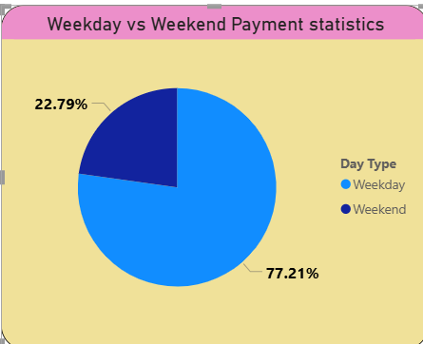
1. Weekday vs Weekend(order_purchase_timestamp) payment statistics
77.21% of payments - weekdays
22.79% of payments - weekends
The majority of transactions happen on weekdays, indicating higher customer activity during working days.
Lower weekend payments suggest that customers are less active or make fewer purchases during weekends.
This pattern may be influenced by factors such as work schedules, delivery expectations, or promotional timing.

Slide 7
2. Number of orders with review score 5 and payment type as credit card
Rating 5 has the highest count (45,369), indicating a large number of highly satisfied customers
Rating 4 follows with 15,050 reviews, showing generally positive experiences
Rating 2 has the lowest among valid ratings (2,502)
Most customers who use credit cards are highly satisfied, as seen from the dominance of 4 and 5 ratings.
The business is performing well in terms of customer experience for credit card transactions.

Slide 8
3. Average delivery days for pet_shop
It takes approximately 11 days for orders to be delivered to customers after purchase.
This delivery time is relatively moderate and may impact customer satisfaction if expectations are for faster shipping.

Slide 9
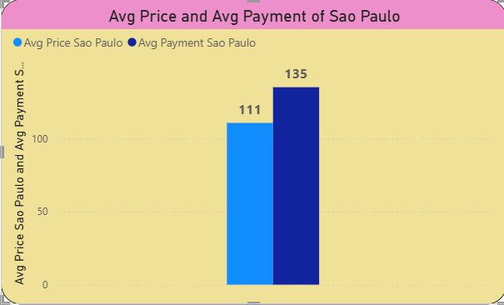
4. Average price and payment values from customers of Sao Paulo city
The average payment (135) is higher than the average product price (111)
This difference indicates that customers are paying more than just the product cost
Reason for difference may be due to additional costs such as shipping charges , taxes , multiple items per order ,service fees etc.

Slide 10
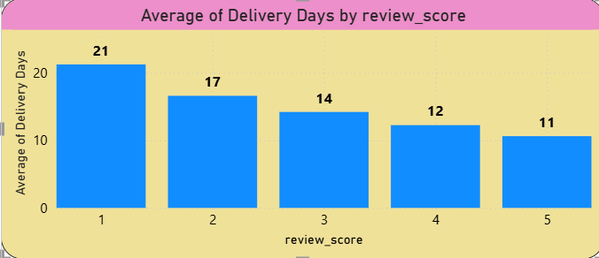
5. Relationship between shipping days vs review scores
Rating 1: 21 days (longest delivery time)
Rating 5: 11 days (fastest delivery time)
There is a clear inverse relationship between shipping time and review score
As delivery time decreases, customer satisfaction increases
Customers who receive orders faster tend to give higher ratings (4 & 5)

Slide 11
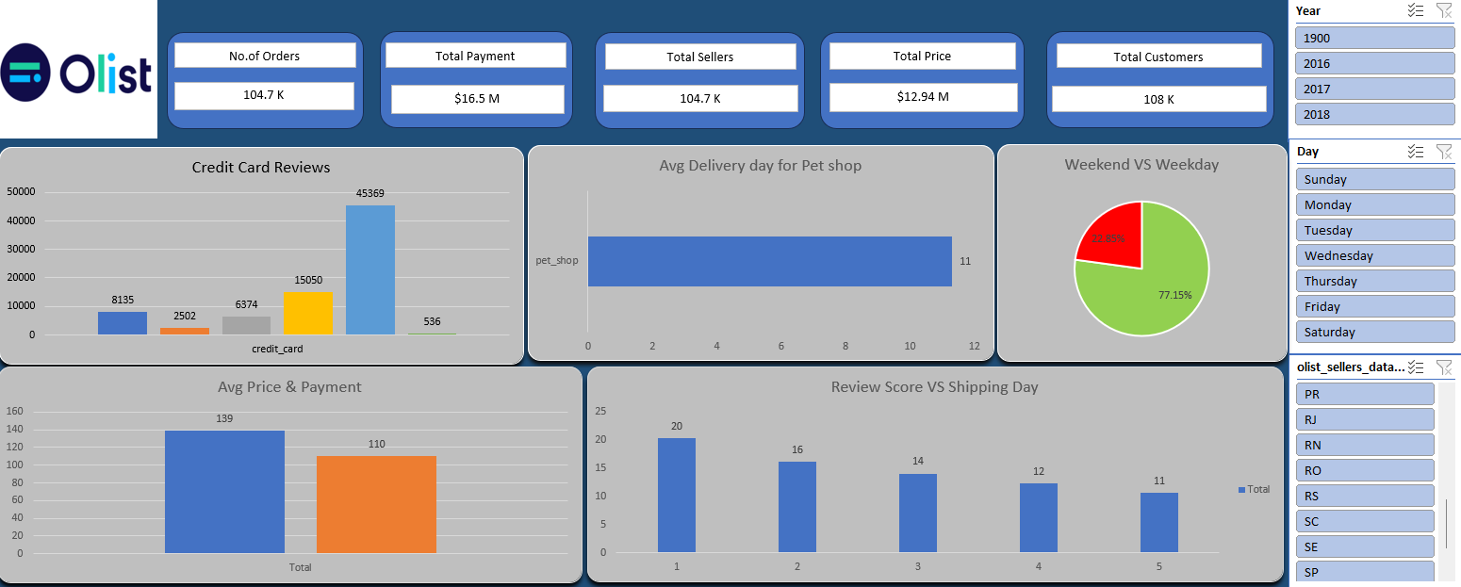
Excel Dashboard

Slide 12
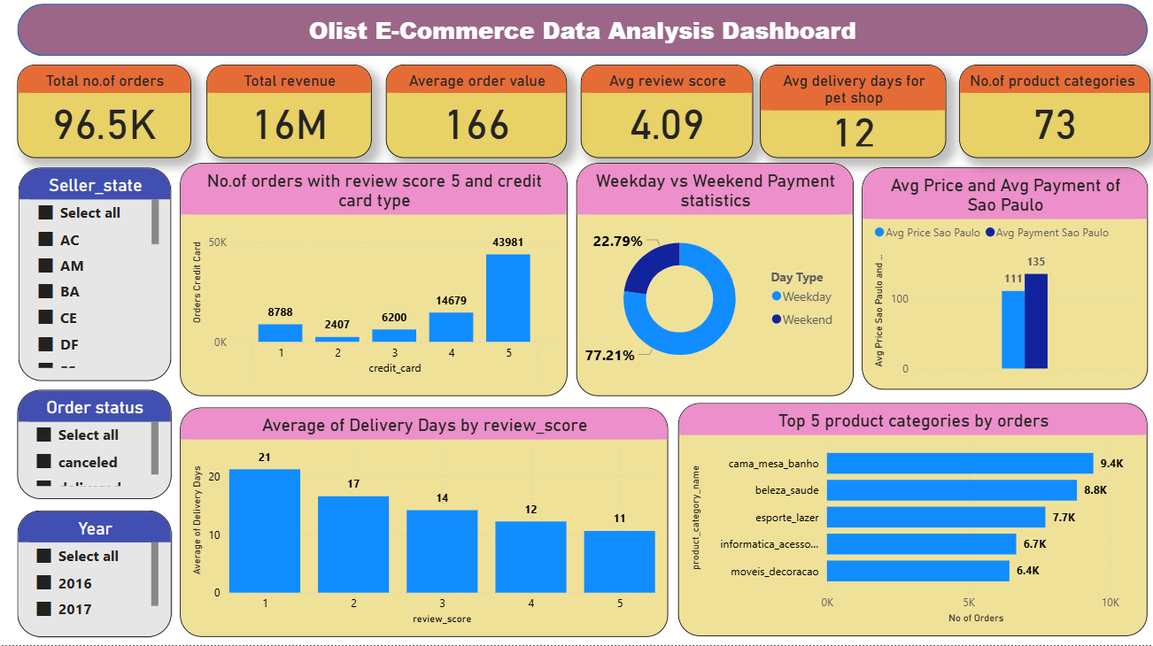
Power BI Dashboard

Slide 13
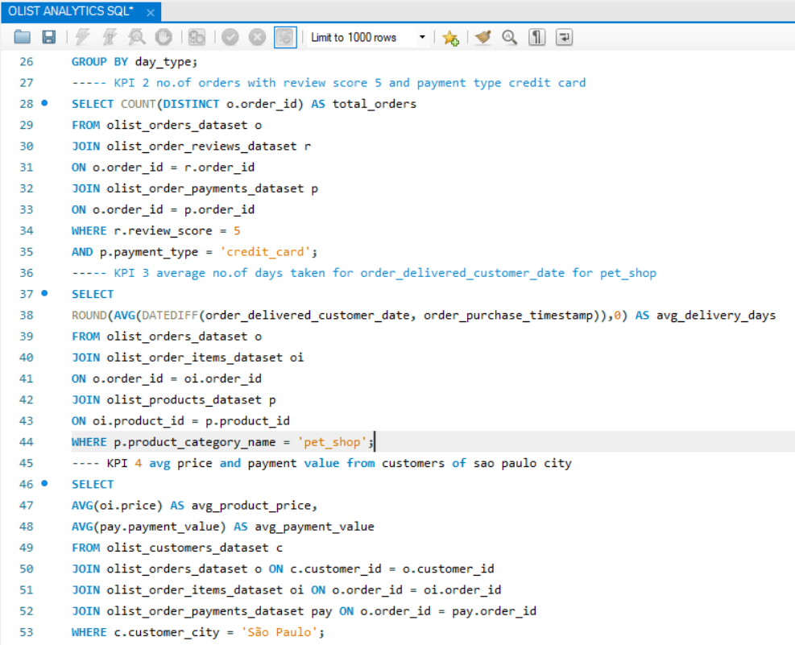
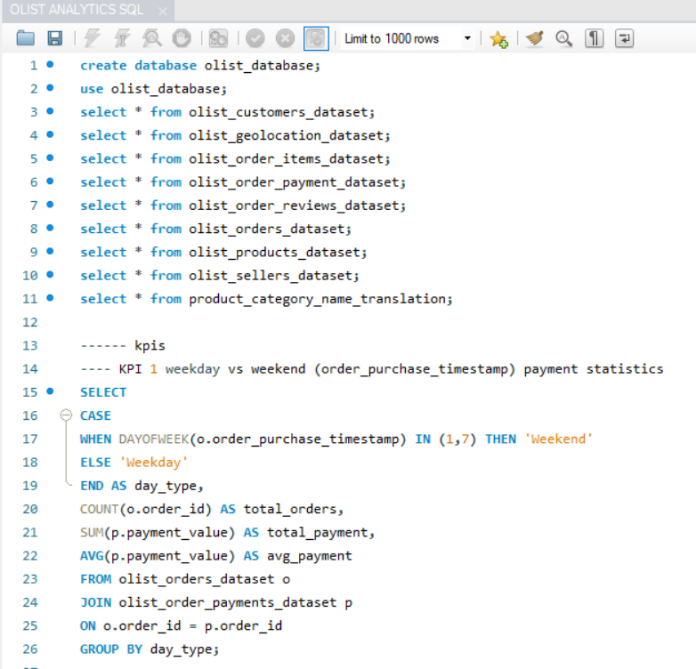
MySQL Queries

Slide 14
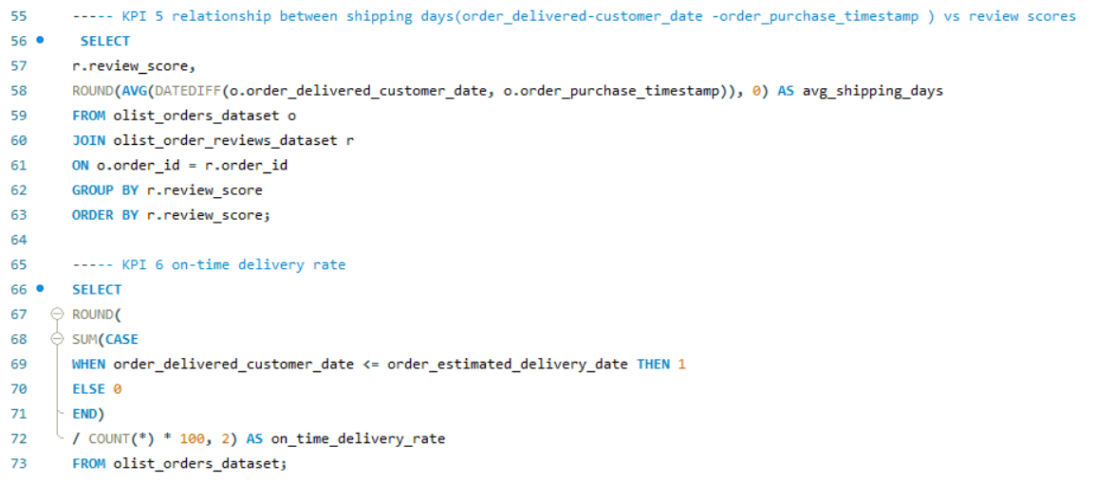
MySQL Queries

Slide 15
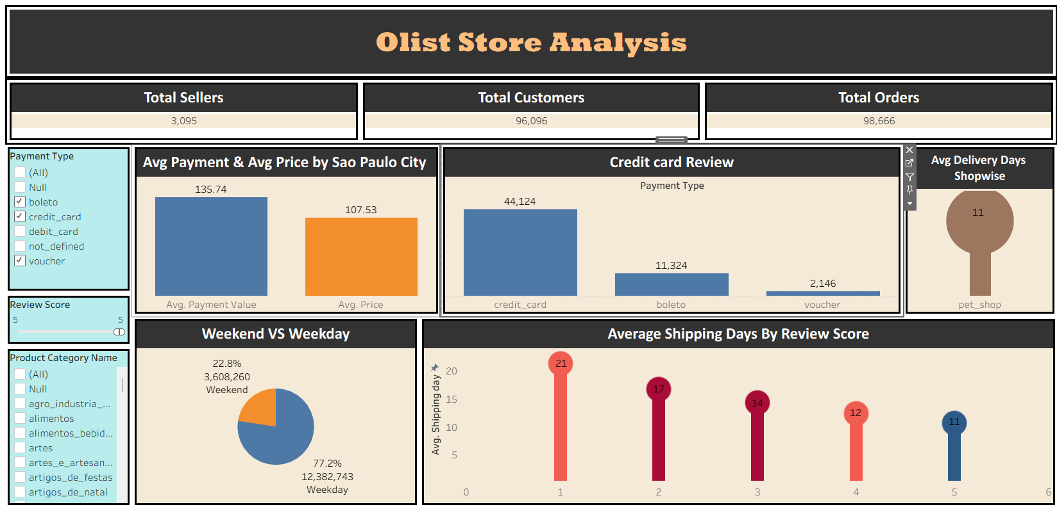
Tableau Dashboard

Slide 16
Summary
Weekday vs Weekend: Majority of payments (77%) happen on weekdays, showing higher customer activity during working days
Credit Card Reviews: Most customers give high ratings (4 & 5), indicating strong satisfaction levels
Pet Shop Delivery: Average delivery time is 11 days, which is slightly high
Sao Paulo Pricing: Average payment (135) is higher than product price (111) due to additional costs
Shipping vs Reviews: Faster delivery leads to higher review scores, proving delivery speed impacts satisfaction

Slide 17
Actionable recommendations and feedback:
Key improvement areas: delivery speed and weekend engagement
Reduce Delivery Time : Optimize warehouse processing and dispatch time and use regional warehouses for faster delivery
Boost Weekend Sales : Introduce weekend-only discounts / flash sales
Improve Low Ratings (1–3 Scores) : Analyze reasons for negative reviews (late delivery, damaged products) and implement return/replacement support
Optimize Pricing & Additional Costs : Provide transparent cost breakdown (price + shipping) and offer free shipping above a threshold

Slide 18
Challenges and solutions:
Challenge 1: Data spread across multiple tables (orders, payments, reviews, products) – difficulty in joining multiple tables
Solution: Understood primary and foreign key relationships and used proper JOINs (INNER JOIN, LEFT JOIN)
Challenge 2 : Date format issue - While importing the CSV file into SQL, the date format was incorrect due to this, functions like DATEDIFF() were throwing errors or giving wrong results
Solution : Converted date columns into SQL-compatible format (YYYY-MM-DD) , saved the file again as CSV format and reloaded the cleaned data into SQL

Slide 19


